Slide 1
Surgical Simulation
Team Elephant(4)
Members:
Aaron Tse
Jeffrey Oduro
Ondra Chan
Kevin De Asis

Slide 2
Introduction (5 sec)
Team Elephant(4)
Members:
Aaron Tse
Jeffrey Oduro
Ondra Chan
Kevin De Asis

Slide 3
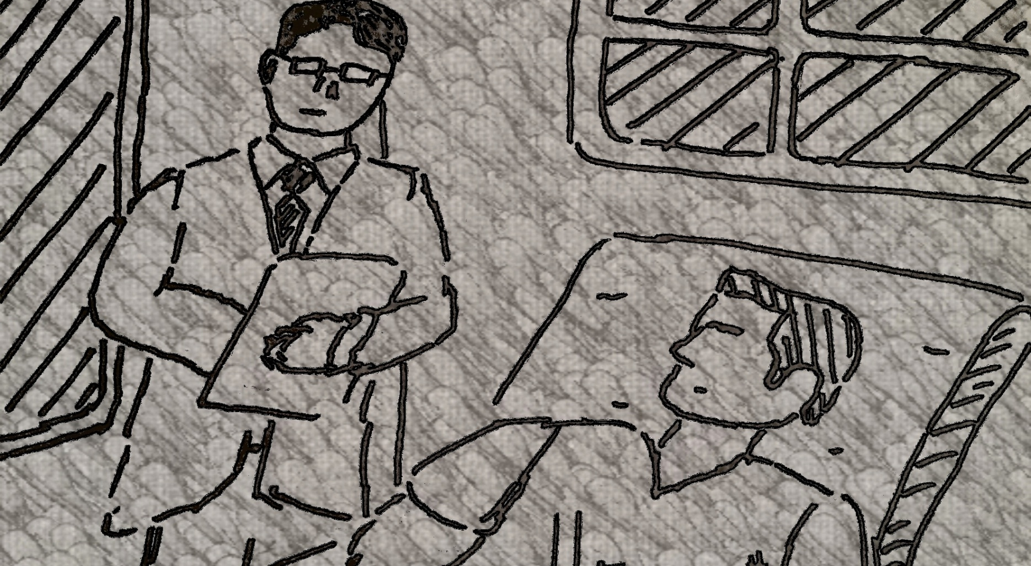
Surgeon with Patient (45 sec)
Scene 1: The doctor, Peter, on the right talking the patient Jen.
Notes:
Scene 1: The doctor, Peter, on the right talking the patient Jen.

Slide 4
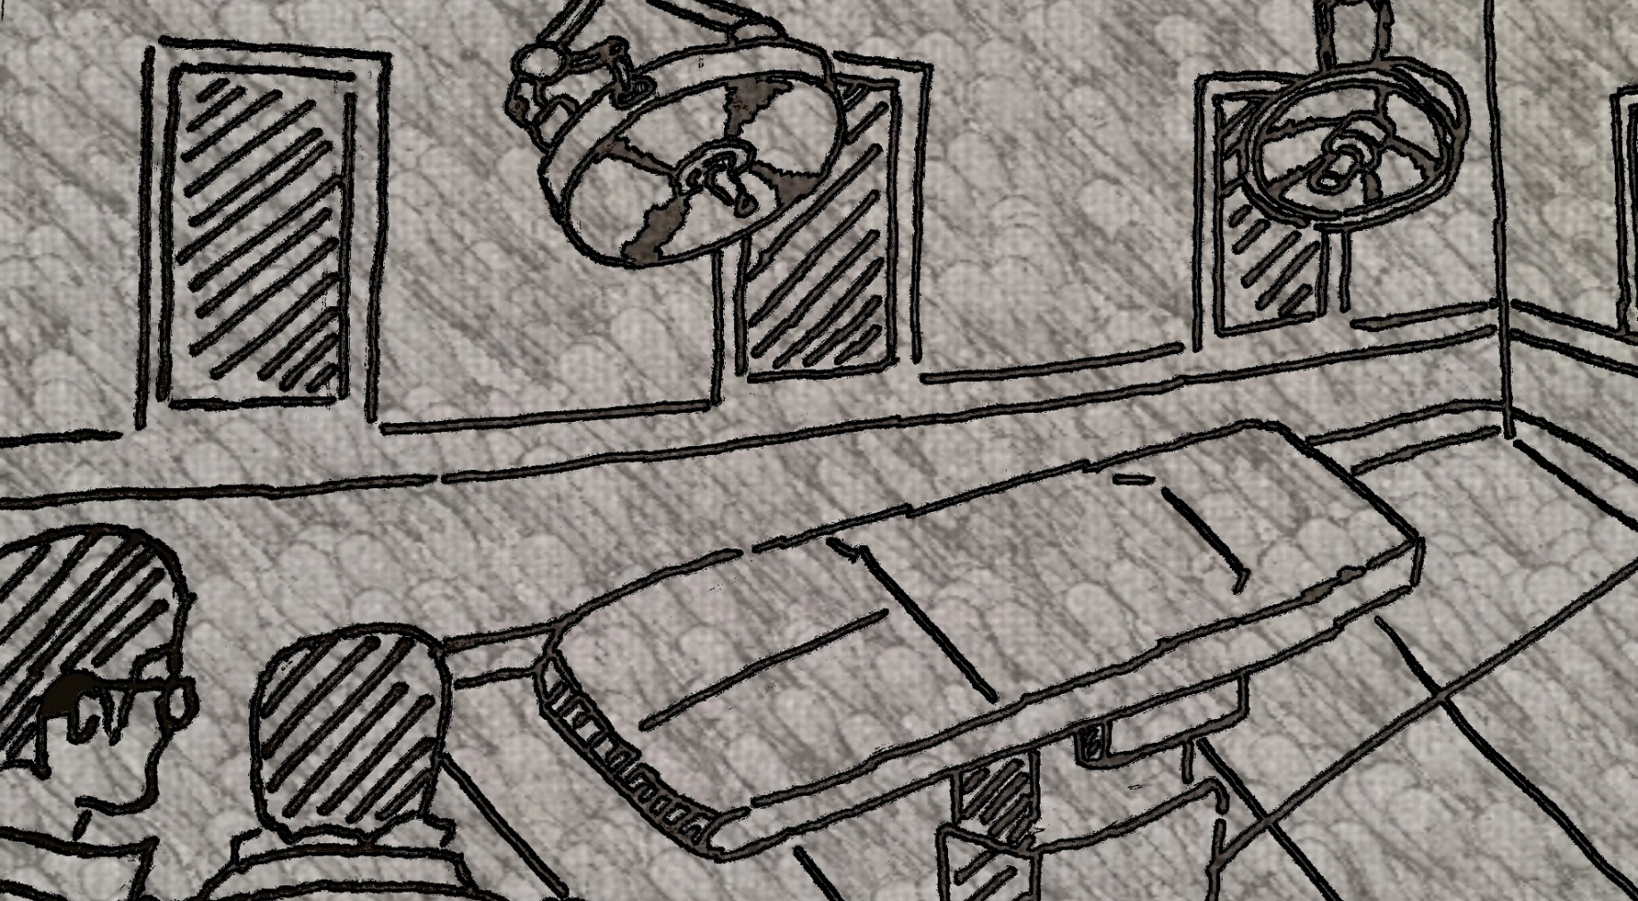
Surgery Room with Doctor and Patient (10 sec)
Scene 2: Transition to the patient being taken to the surgery room.
Notes:
Scene 2: Transition to the patient being taken to the surgery room

Slide 5
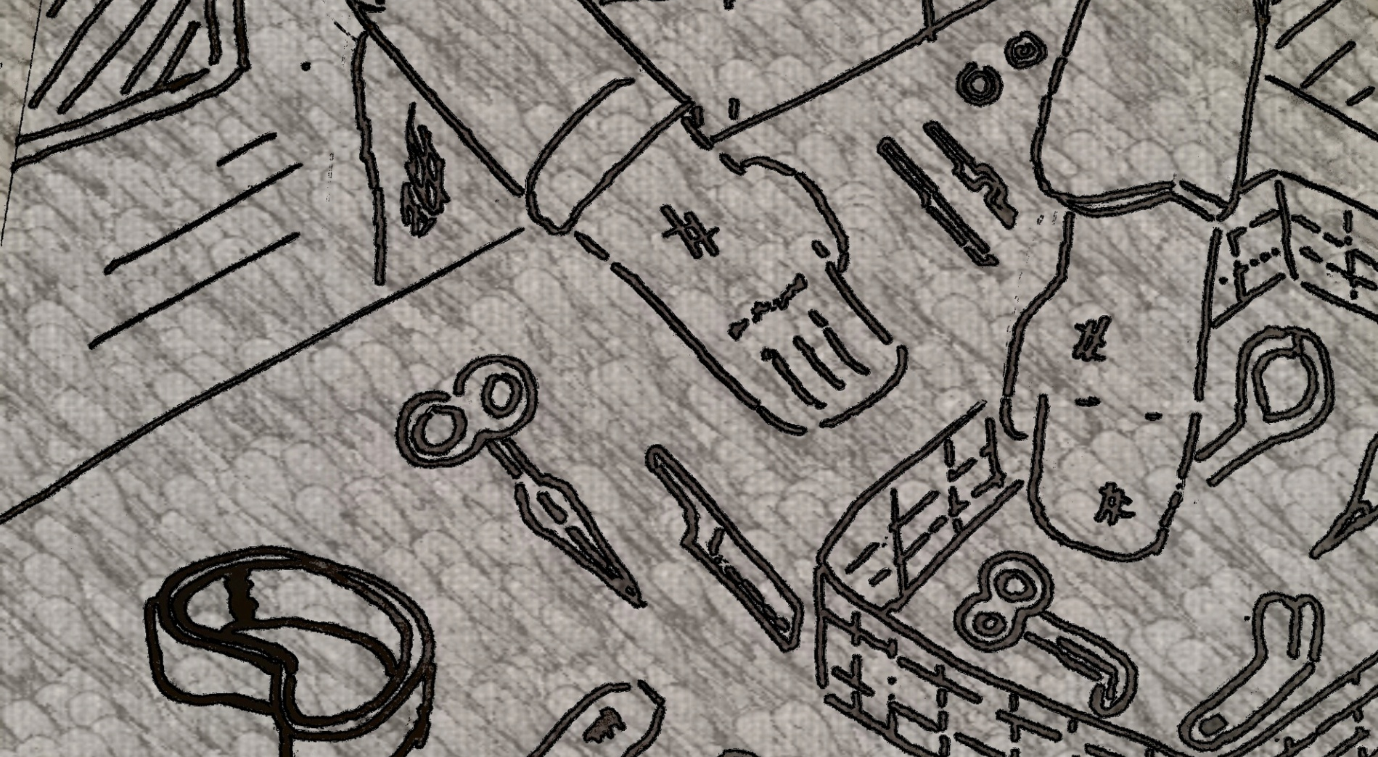
Prep Material (10 sec)
Scene 3: A zoom in showing the doctor preparing various medical tools.
Notes:
Scene 3: A zoom in showing the doctor preparing various medical tools.

Slide 6
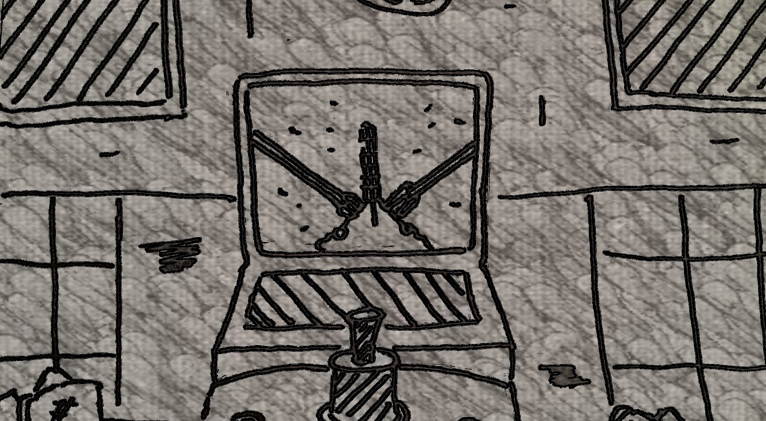
Surgery Training (15 sec)
Scene 4: A flashback to earlier showing Peter instructing Jack who is using a training apparatus to practice for the surgery.
Notes:
Scene 4: A flashback to earlier showing Peter instructing Jack who is using a training apparatus to practice for the surgery.

Slide 7
Transition from training to surgery (5)
Scene 5: The scene transitions into the surgery room to show Jack performing the real surgery
Notes:
Scene 5: The scene transitions into the surgery room to show Jack performing the real surgery

Slide 8
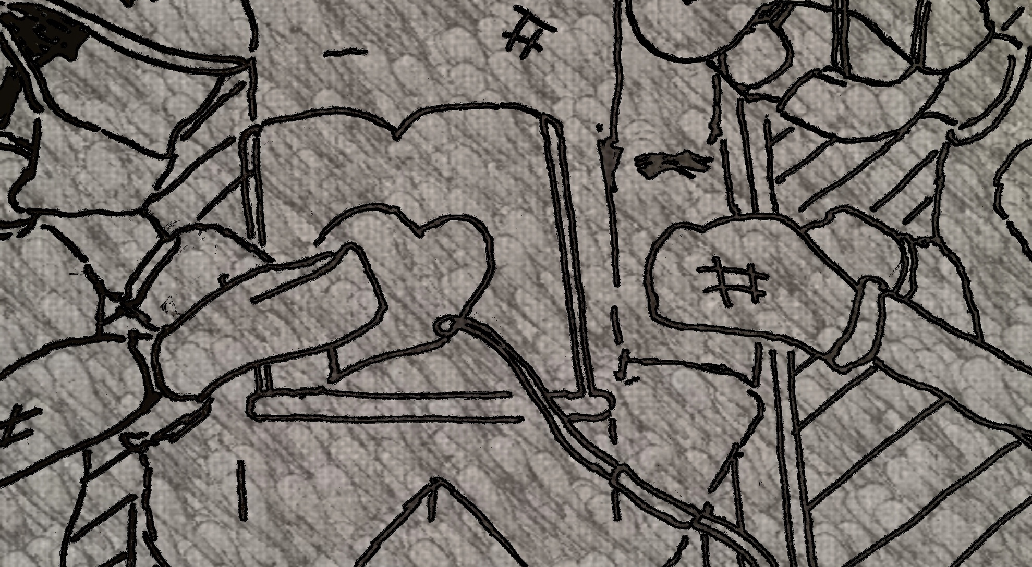
Operation (50 sec)
Scene 6: The operation being done.
Notes:
Scene 6: The operation being done.

Slide 9
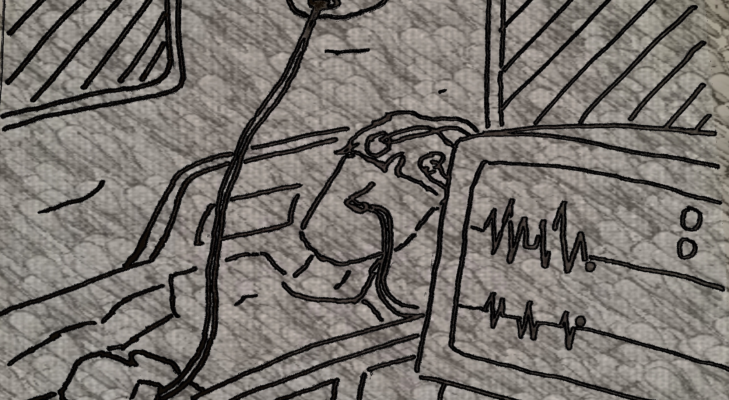
Flat-line heart rate monitor (10 sec)
Scene 7: Unfortunately the patient is lost.
Notes:
Scene 7: Unfortunately the patient is lost.

Slide 10
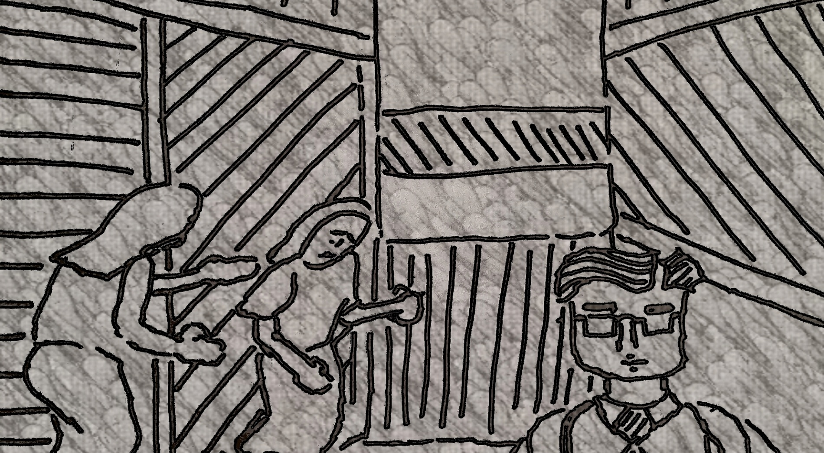
Talking to the family and walkout (15 sec)
Scene 8: The doctor is scene giving the bad news to family.
Notes:
Scene 8: The doctor is scene giving the bad news to family.

Slide 11
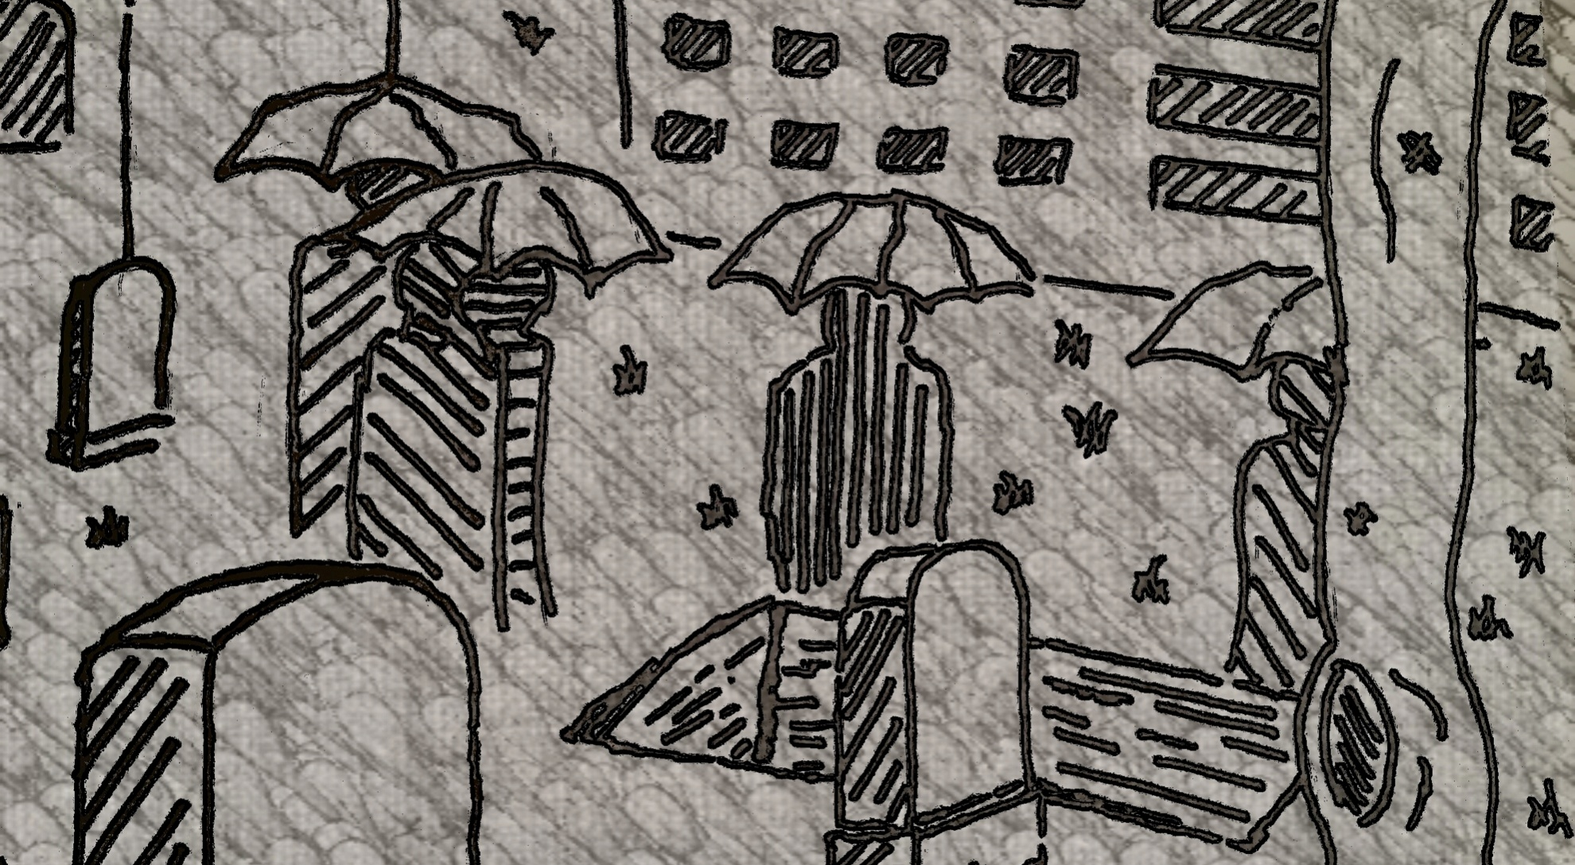
Funeral (20 sec)
Scene 9: Jump to the funeral of the patient.
Notes:
Scene 9: Jump to the funeral of the patient.

Slide 12
Outro 10 sec
Scene 10: Roll the credits.
Notes:
Scene 10: Roll the credits.

